Slide 1





Final
Data
Project
Hamda Mohamed

Slide 2

About me
Resourceful, analytical, decisive.
Effective communicator
A love for efficient processes.
Maths Tutor/ Admin Assistant
Trainee Data Analyst
Admin in Education
Niyo Bootcamp
Notes:
Born and raised in london, I graduated high school and became a maths tutor .I have instinctively gravitated to roles that required an organised and analytical nature. I was then trainee analyst This is where I was introduce to excel, which I still use daily and what started my passion for analytics. I'm currently an office admin in a school and have been working towards a career in data for the last year.

Slide 3
Overview
1
2
3
4
NIYO
DATA SET
ANALYSIS
INSIGHTS
Notes:
This is an overview of what we will be covering today, I will speak on my experience on this bootcamps, move on to explain the data set, and then the analysis and finally some key insights I would like to share.

Slide 4




Key Skills
Notes:
These are the software that I feel I have progressed the most with. I have some experience and tableau and excel, but I have really been able to put them into practice using large data-sets. I was totally new python and SQL and have really enjoyed the process of learning this skill.

Slide 5
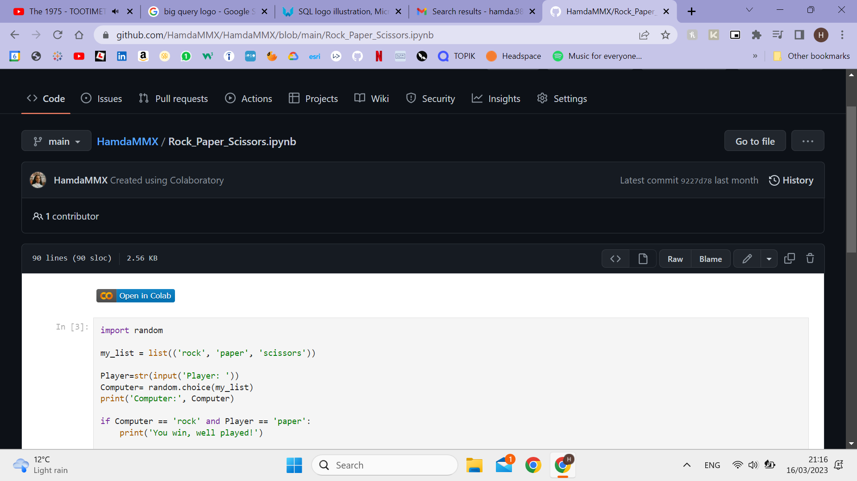
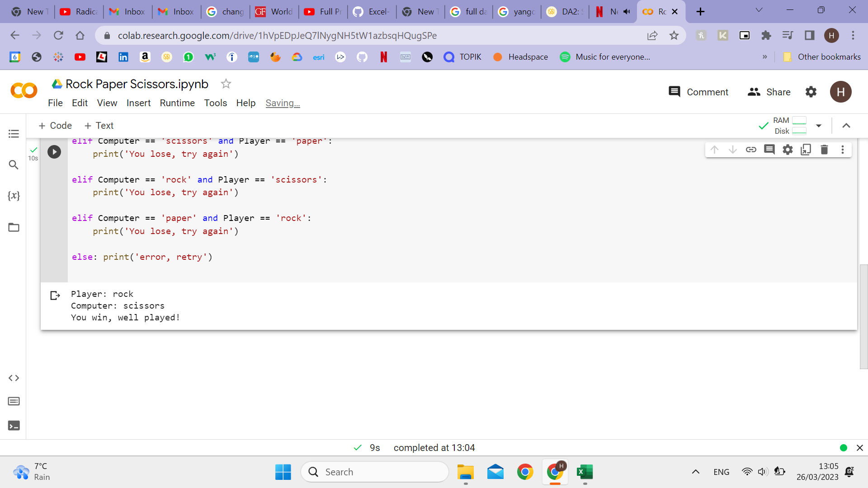
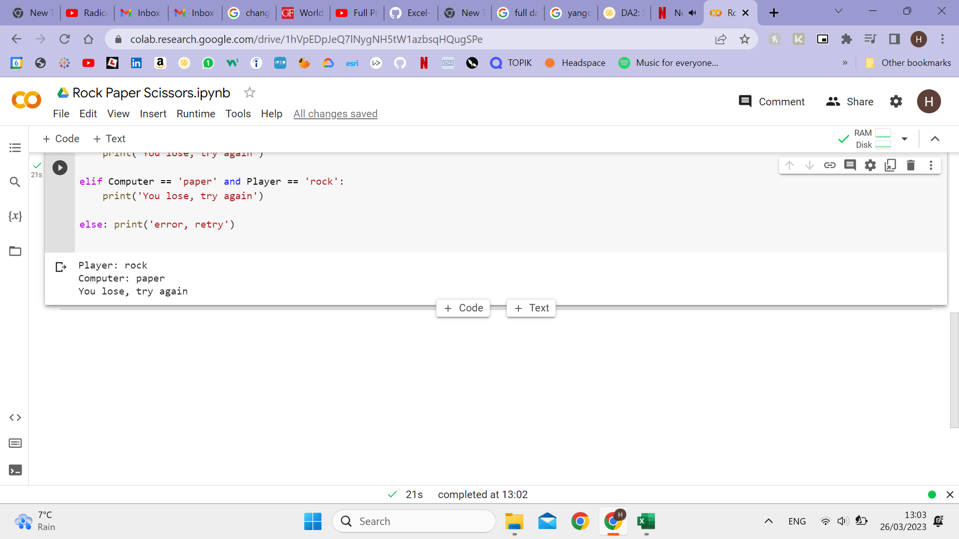
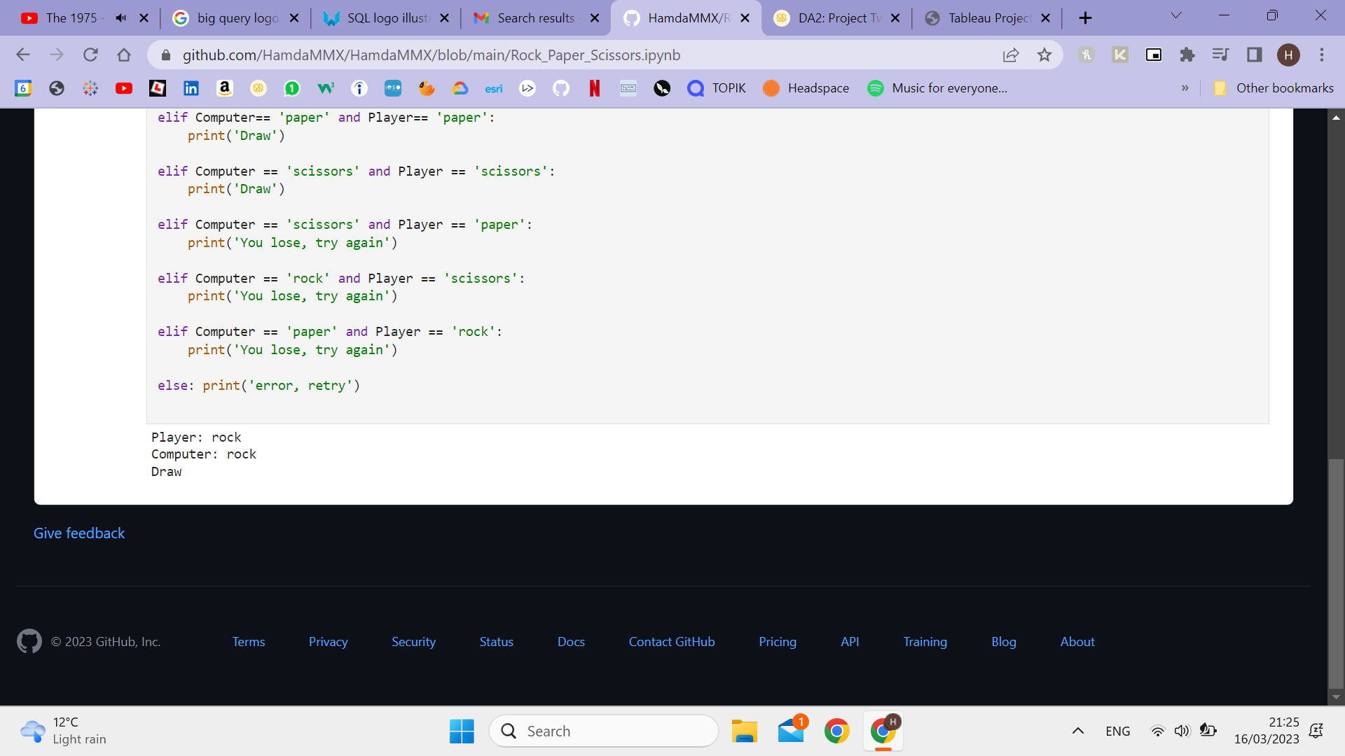
Notes:
This was my favourite little code exercise in python, it's a rock paper scissors game. It uses lists, random selection, input and the if else function.
Something that I enjoyed was making the code more streamline and finding ways to achieve the same result with less code

Slide 6
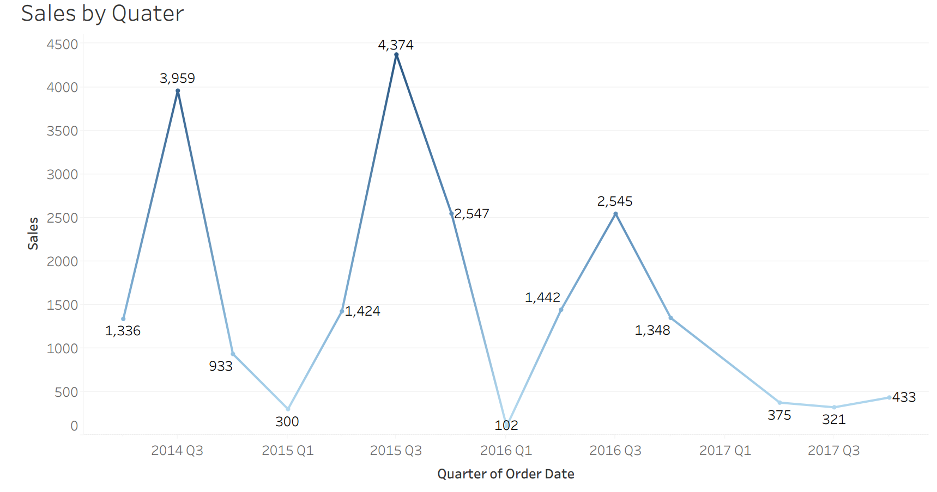
Notes:
This was using tableau, I really enjoyed learning more about the best practises of visualisations, how to make it more readable and striking whilst clearly showing a trend, so in this its clear Quater 3 is the most successful quater

Slide 7
Data Set
Notes:
I chose to use a data set on retail transactions, my previous expiereicne has been in education, I thought it would be interetsing to do something business related.

Slide 8
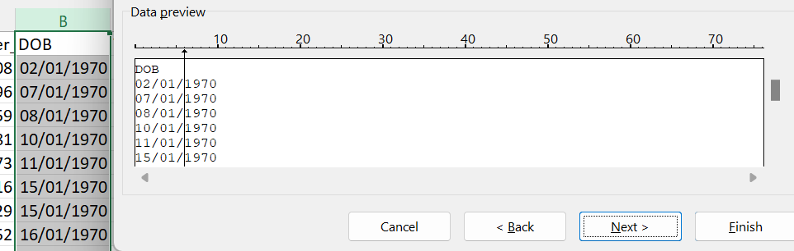
Text to Columns
Notes:
So the first thing i did was use excel to clean and manipulate the data, so it was ready to work with, this included splitting the DOB so i could just use the year to compare ages, and formatting dates as well as numbers

Slide 9
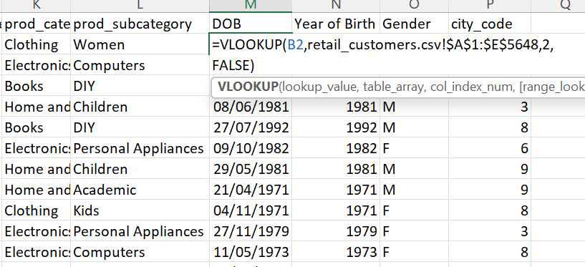
V-lookup
Notes:
I also used vlookup to join two data sets togethe using Customer_id which they have in common, to make it easier to use across the different software.

Slide 10
Analysis

Slide 11
What are the top-selling categories and stores?
What is the average price and quantity bought
How does the superstore's sales performance vary by Quarter?
How much do refunds cost the superstore?
What are the total sales and how has it changed over time?
Key Questions

Slide 12
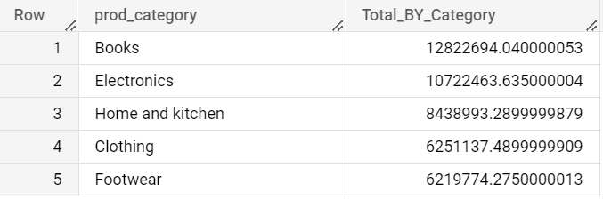
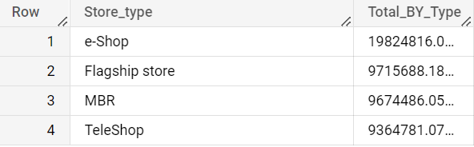
Notes:
This is a table showing the top 5 Product categories in terms of sales. SO books and Electronics have sold the most.
--Sum-- --Group By--
--Having--

Slide 13
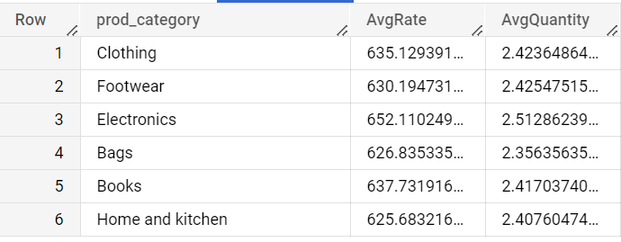
Notes:
Average

Slide 14
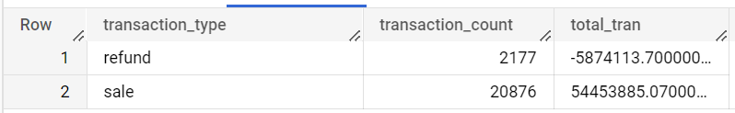
Notes:
I used Case When and the SUM function to group transactions into either sale which are => 0 or else it would be a refund, I then used count to retieve the number of refind the compnay have recieved and we can see it is aroud 10 times less that the number of sales
--Case When--
--SUM--

Slide 15
Insights

Slide 16
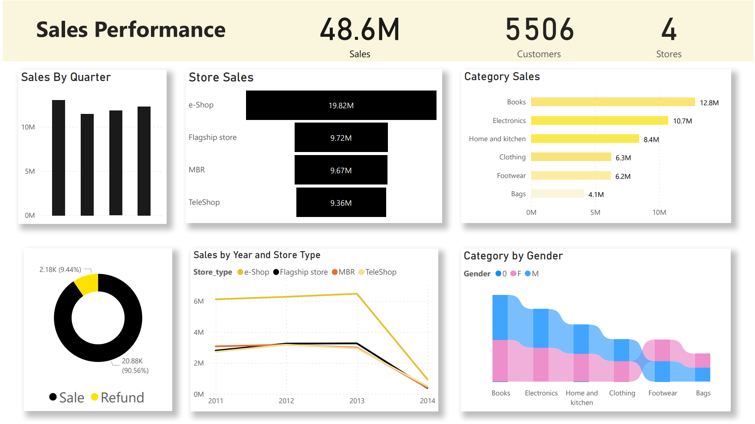
Notes:
The Top selling store s are the e-shop and flagship, however the e-shop is over twice as successful as the flagship. Recent trends show digitised experiences are favoured
The average rate for items in this store $634. This suggest we sell higher end products and can inform marketing decisions.
The total sale remain steady per quater, suggesting sales are even all year round. Suggesting we could improve holiday marketing and include insentives. To boost quater 2, summer sales would be appropriate.
Refunds cost the store around 10% , the avaerge for stores in the USA is 20%.
Total number of customer since 2011 stands at 5506
The total sales stand at 48.6 M since 2011 , this fell drastically in 2014, this because we only have data for the first two months

Slide 17
The Top selling store s are the e-shop and flagship, however the e-shop is over twice as successful as the flagship.
The average rate for items in this store $634.
The total sale remain steady per quarter, suggesting sales are largely even all year round.
Refunds cost the store around 10% , the average for stores in the USA is 20%.
Total number of customer since 2011 stands at 5506
The total sales stand at 48.6 M since 2011
Insights
Notes:
The Top selling store s are the e-shop and flagship, however the e-shop is over twice as successful as the flagship. Recent trends show digitised experiences are favoured
The average rate for items in this store $634. This suggest we sell higher end products and can inform marketing decisions.
The total sale remain steady per quater, suggesting sales are even all year round. Suggesting we could improve holiday marketing and include insentives. To boost quater 2, summer sales would be appropriate.
Refunds cost the store around 10% , the avaerge for stores in the USA is 20%.
Total number of customer since 2011 stands at 5506
The total sales stand at 48.6 M since 2011 , this fell drastically in 2014, this because we only have data for the first two months

Slide 18
Questions
Notes:
I think these two solution would work really well together when paired with any digital workspace.

